Slide 1

INTEGRATED WITH INTEGRITY!

Slide 2

INTERACTIVE CANVAS

Slide 3
IOT

Slide 4
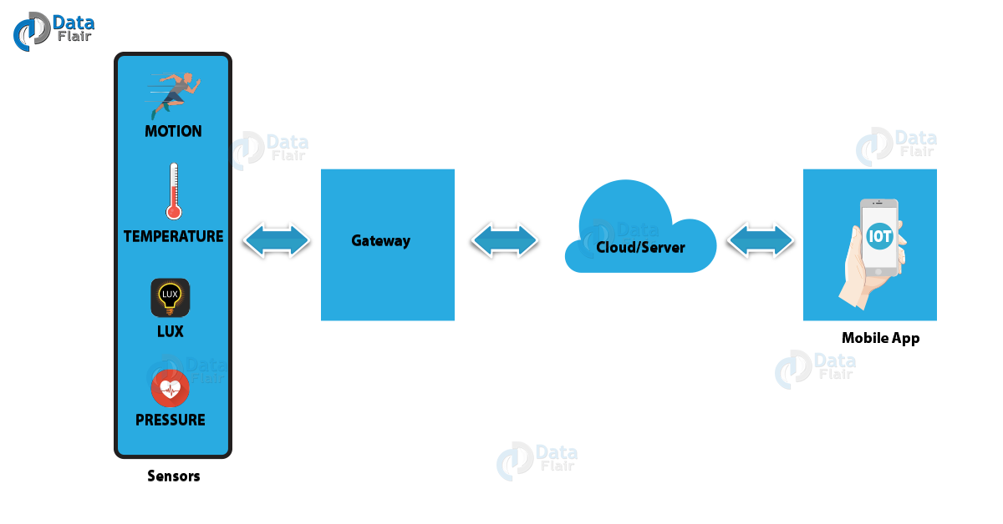
HOW IT WORKS ?

Slide 5
PICTIONARY

Slide 6
How to play the game :
One member from each team will perform the given topic by drawing it on the blackboard.
The team will try to guess the topic.
Time -1 min for each team.

Slide 7
RULES
Not allowed to speak or make any kind of noise.
No gestures are allowed .
No letters or numbers are allowed on picture.

Slide 8


Slide 9
DRONES

Slide 10
Drones
What exactly drone is?
Invention of drones
Electronics in drones
Uses of drones.
Examples

Slide 11
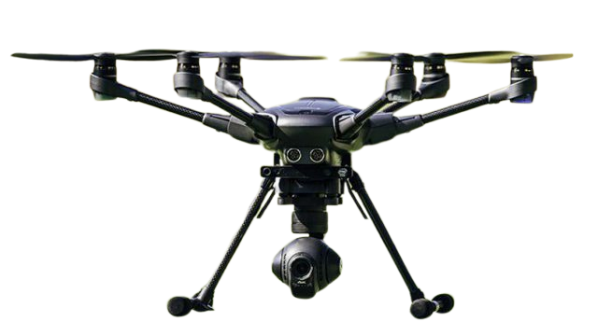
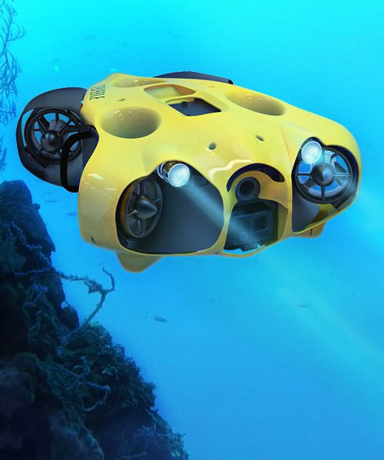
1) Prosumer drone
2) Underwater drone

Slide 12
SOPHIA ROBOT

Slide 13
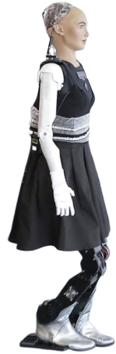
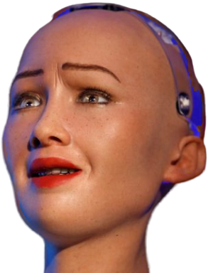
Sophia robot
Features :
Worlds first humanoid robot .
Uses Artificial Intelligence .
Imitates Human gestures and facial expressions .
Able to answer any certain question .

Slide 14
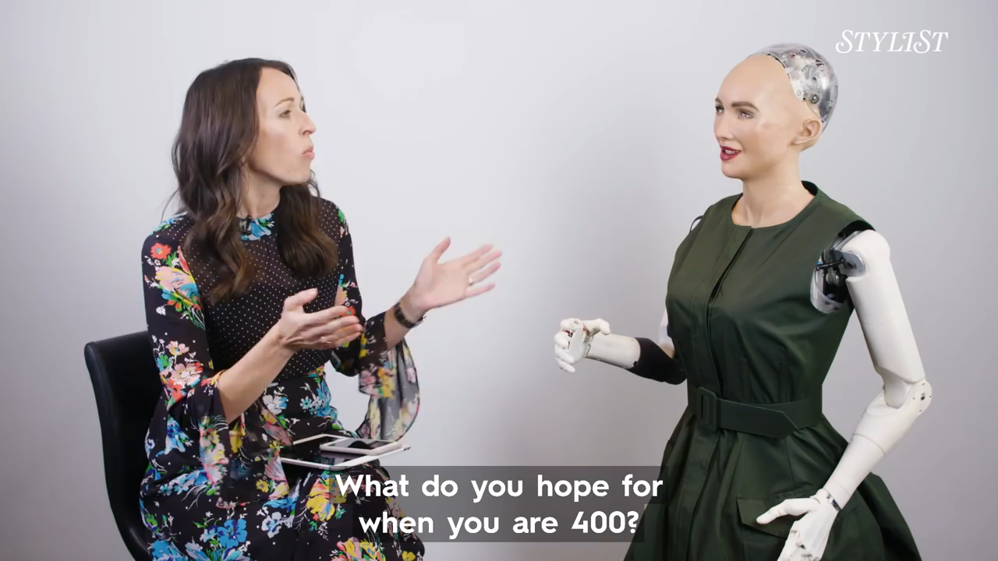

Slide 15
Activity
COUNTENANCE

Slide 16
Rules
It’s a team activity.
Usage of internet is strictly prohibited.
All teams will be given same question at a time.
There is a time limit of 10 seconds for all teams.
The answer of the questions is a numeric value(number).
The team whose answer will be correct or closer to correct answer will get a point.
The answer submitted after the given time will be discarded.

Slide 17

1. How many countries are there in this world?
2. What is the height of shortest man in the world?
3. How many national parks are there in asia?
4. How many articles in the Indian constitution?
5. How many bones are there in snake?

Slide 18
6. What is the length of Krishna river?
7. In which year telephone is invented?
8. What is the diameter of sun?
9. How many muscles are there in human body?
10. What is the height of Mount Everest?

Slide 19
11. How many countries are there in South America?
12. What is the distance of Ozone layer from earth surface?
13. How many bones are there in a human ear?
14.What is the length of the shortest river in the world?
15. What is the distance between earth and mars?

Slide 20
VINDICATE

Slide 21
RULES
One speaker has to come on dice .
Pick a chit and read the topic.
Speaker has to speak for 60 seconds on that topic.
For first 30 seconds , speaker has to speak in favor of the topic and for next 30 seconds against the topic.
Audience have to inform the speaker that 30 sec are over by clapping for once.

Slide 23
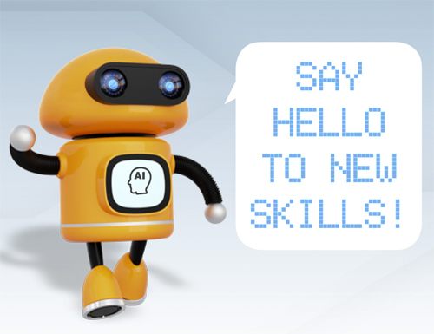
TECHNICAL SESSION

Slide 24
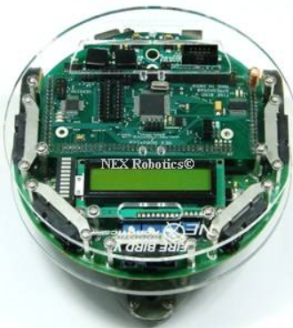
FIREBIRD V

Slide 25
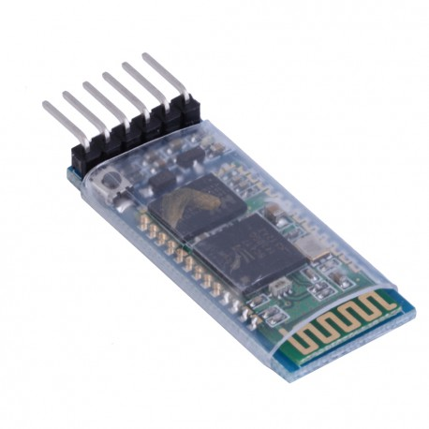


Slide 26
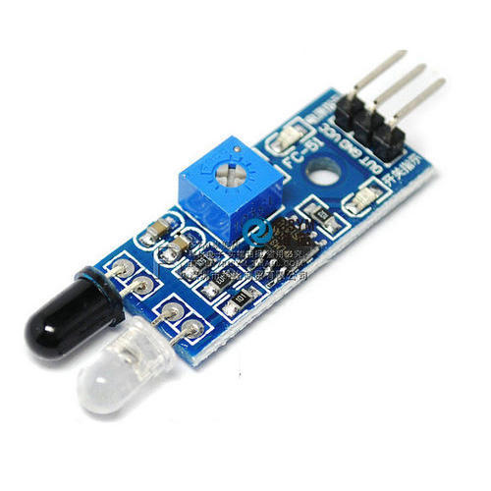
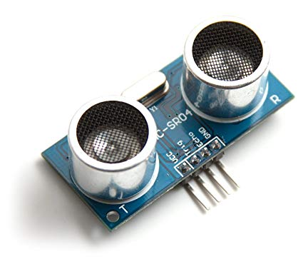

Slide 27
Explore Yourself in…
E-yantra Robotics Competition
(IIT Bombay)
Texas Instruments IICDC
KPIT Sparkle
Smart India Hackathon
WCE Hackathon

